Slide 1
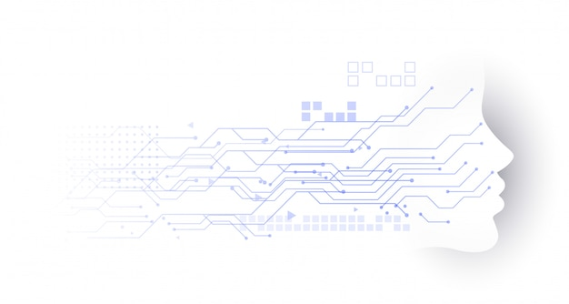

Mahakal Institute of Technology
Department of Artificial Intelligence and Data Science
Minor Project-I on
“Human Drowsiness Detection System”
Presented by :
Arpita Vishwakarma 0704AD2110009
Disha Pandey 0704AD2110013
Mahak Chouhan 0704AD2110021
Under the guidance of :
Prof. Neeraj Sharma

Slide 2
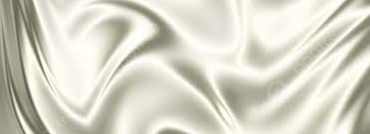
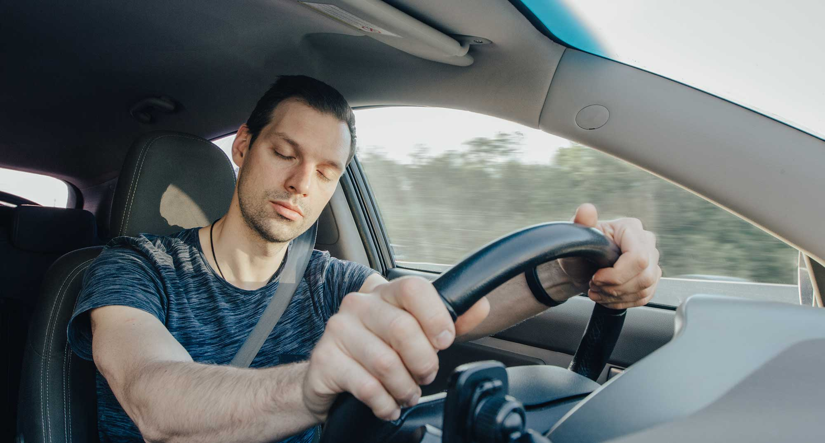
HUMAN
DETECTION SYSTEM

Slide 3
Introduction
Literature Review
Problem Statement
Analysis Overview
Design Overview
Screenshots
Limitations & Future Scope
Conclusion
References
1
2
3
4
5
6
7
8
9

Slide 4

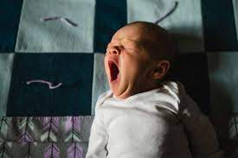
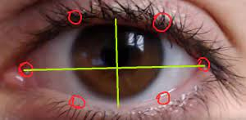
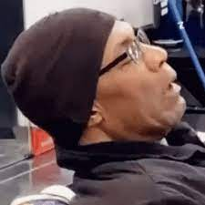
In this project, we have build a human drowsiness detection system that will detect if the eyes of the user are close for too long and infer if the user is sleepy or inactive. The drowsiness detection system can be used as a user in a two ways:-
It can be a safety technology that can prevent accidents that are caused by drivers who fell asleep while driving.
It can also be used by the students who are working on the laptop/pc for too long and fell asleep while doing work.
BABY YAWNING
EYE_DETECTION
UNCLE NODDING

Slide 5

https://github.com
https://github.com/italojs/facial-landmarks-recognition/blob/master/shape_predictor_68_face_landmarks.dat (used to download the .dat file in which there are 68 face landmarks)
https://stackoverflow.com (used for the help to view the solution for the error in the code)
https://www.python.org (used to install python )
https://pypi.org/project/pip (is use to install pip)
https://www.anaconda.com/download (used to download anaconda)
https://www.youtube.com
https://pypi.org/project/opencv-python (used to install opencv-2)
https://pypi.org/project/dlib (used to install dlib)
https://pypi.org/project/playsound (used to install playsound)
https://pypi.org/project/pygame (used to install pygame)
https://pypi.org/project/python-time (used to install time)

Slide 6
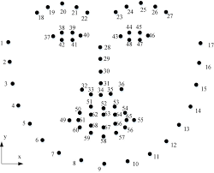
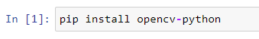
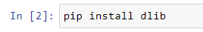
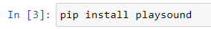
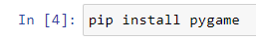
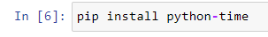

Slide 7

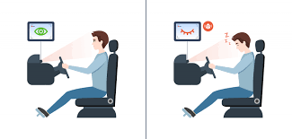


A webcam or inbuild camera is placed infront of the person which is more suitable to use but firstly the physical signs are located in order to come up with a drowsiness detection algorithm that is reliable and accurate.
Then the system analyze and determines whether the person eye’s are open or shut.
If the eyes are shut for more than 6 second then the system beeps to alert the person.
Lighting intensity while person tilt there face left or right are the problems occur during detection of eyed and mouth.

Slide 8
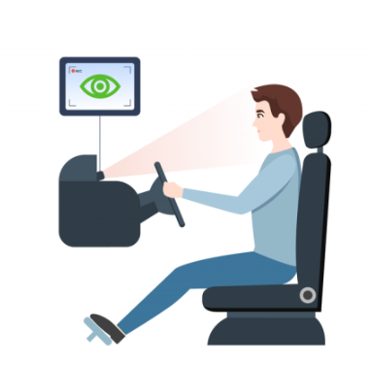
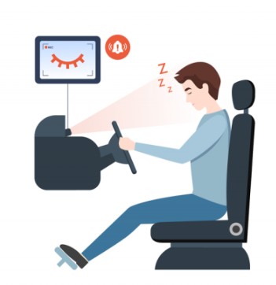

Slide 9

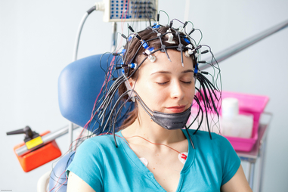
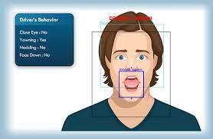
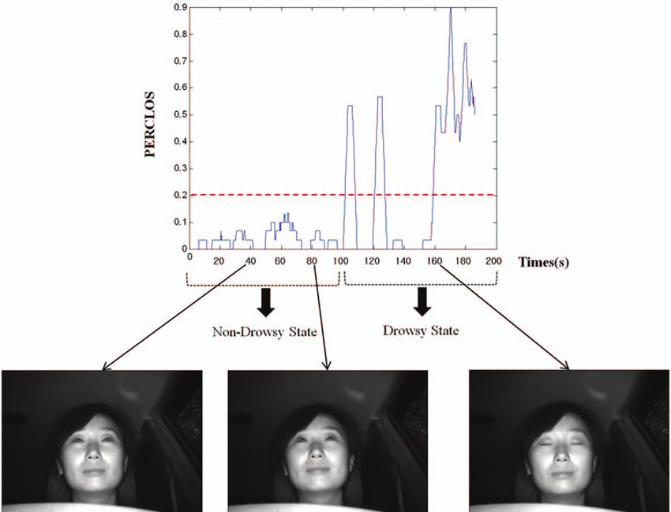
There are several method which use different approaches to detect the drowsiness signs. Some of them are like :
Drowsiness detection using ELECTROENCEPHALOGRAPHY (EEG)
Yawning detection method
Percentage of eye closure (PERCLOS)

Slide 10
The proposed techniques is primarily based on eye blinking of a person which can be behavioural measures. The aim id to detect the closed eye and open eye and to give alert to the person. This can be done by placing a camera or recording device infront of a person and capture real time video using OpenCV and Dlib. The system is executed in python and processing is done in laptop’s camera.
The work is mostly divided into three steps:
Face , eye and mouth detection
In this step face is detected by the user of dlib library. Shape predictor that is implemented in dlib library used to find landmarks . The predictor gives 68 landmarks that can be applied to localize regions of face such as eyebrows ,nose etc.

Slide 11
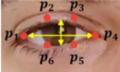
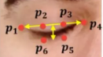
Eye closure detection
Each eye are characterized by 6 coordinates which are then applied on the equation which is known as Eye aspect ratio (EAR) which reflects the width and height of coordinates can be derived.
The distance between vertical eye landmarks is computed in denominator and those of horizontal eye landmarks are computed in numerator using the formula for Euclidean distance.
EYE ASPECT RATIO = ||p2-p6||+||p3-p5||
2||p4-p1||
Landmarks for Open eye
Landmarks for closed eye

Slide 12
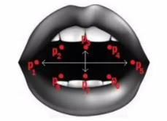
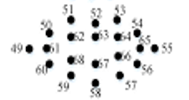
3. Open mouth detection
Yawning is characterized by wide opening of mouth. Mouth is characterized with the help by 20 coordinates . Using this, the distance between the lips is calculated which is the difference between the top lip and bottom lip which determines whether person mouth is open.
If distance is greater than threshold amount then it determine the state of drowsiness.
MOUTH ASPECT RATIO = ||p2-p8||+||p3-p7||+||p4-p6||
2||p1-p5||
20 coordinates of mouth landmarks

Slide 13
Tools and image processing libraries
OpenCV
Python
Dlib
pygame
High-Level Language: Python is a high-level programming language that emphasizes simplicity and readability.
Clean Syntax: Python's clean and easy-to-understand syntax reduces the learning curve for beginners.
Interpreted Language: Python is an interpreted language, which means you can run code line by line without the need for compilation
Open Source: Python is open source, meaning it's free to use and has a large and active community of developers contributing to its growth

Slide 14
OpenCV (Open Source Computer Vision Library) is a popular open-source computer vision and image processing library
Open-Source: OpenCV is a free and open-source library, making it widely accessible for computer vision and image processing projects.
Machine Learning Integration: OpenCV can be integrated with machine learning libraries like scikit-learn and TensorFlow to perform advanced computer vision tasks, such as image classification and object detection
Real-Time Processing: OpenCV is well-suited for real-time applications, enabling tasks like object detection, face recognition, and motion tracking in live video streams.
Camera Calibration: It can calibrate cameras and rectify images to correct distortions, making it useful in computer vision applications involving cameras.
Tools and image processing libraries
Pygame
Python
Dlib
OpenCV

Slide 15
Pygame is a popular and user-friendly library for creating 2D games and multimedia applications in Python.
Simple and Easy to Learn: Pygame's simple and intuitive API makes it suitable for both beginners and experienced developers
Graphics and Sound: It provides features for 2D graphics rendering, image loading, sprite handling, and sound effects, enabling game development.
Game Loop: Pygame simplifies game development by handling the game loop, allowing developers to focus on game logic and mechanics.
Its simplicity, active community, and broad range of features make it a preferred choice for developers interested in creating interactive and entertaining software.
Tools and image processing libraries
Dlib
Pygame
OpenCV
Python

Slide 16
Dlib, a C++ library with Python bindings, offers machine learning capabilities, particularly in the domain of object detection, image classification, and shape prediction.
Facial Landmark Detection: Dlib can predict facial landmarks, such as the position of eyes, nose, and mouth. This feature is essential for applications like facial alignment and emotion analysis.
Integration with Other Libraries: Dlib can be integrated with other libraries like OpenCV and TensorFlow, providing comprehensive solutions for complex machine learning challenges.
Tools and image processing libraries
Dlib
Pygame
OpenCV
Python

Slide 17

There are various UML diagrams (UML stands for Unified modelling language) which is way to visually represent the architecture, design, and implementation of complex software systems. So here also the drowsiness detection system represent the various UML diagrams such as use case diagrams, sequence diagram, class diagram, Dataflow diagram.
A data flow diagram (DFD) is a visual representation of how data flows through a system or process.
A use case diagram is a graphical representation of a user's possible interactions with a system
A class diagram describes the types of objects or classes in the system and various kinds of static relationships which exist between them.
A sequence diagram is a graphical representation of the flow of messages between objects in a system.

Slide 18
USE CASE DIAGRAM
Start/Stop
Capture
Camera
Face Extraction
Eye region extraction
User
Analysing
Drowsy status detection
Detection
Alarm running with notification

Slide 19

Sequence Diagram
CAMERA
USER/DRIVER
DETECTION
ALARM
1. on/off
2. Captures images
3. Extracts face
4. Extract left eye, righteye
6. Analyse eyes opened or closed
7. detection
8. Check status
9. Ring alarm
10. Alert user and gives notification

Slide 20
DATAFLOW DIAGRAM
Video Input
Face Detection
Feature Extraction
Eye status
Mouth status
Eye closure and blinking rate
Mouth opening and closure
Classification
Drowsy
No
Yes
Gives alert with notification
warning

Slide 21
CLASS DIAGRAM
USER
DETECTION
Face
Left eye
Righteye
Opened
Closed
Time Closed
features
Opening eye()
Closing eye()
Sleepy()
Opened detect()
Closed detect()
Extraction()
Calculation()
captures
Drowsy alert
detecting
CAMERA
ALARM
Image
Face area
alerts
Ring
Notification
Capture()
Alert()
Request()
Message()

Slide 22
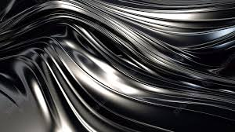

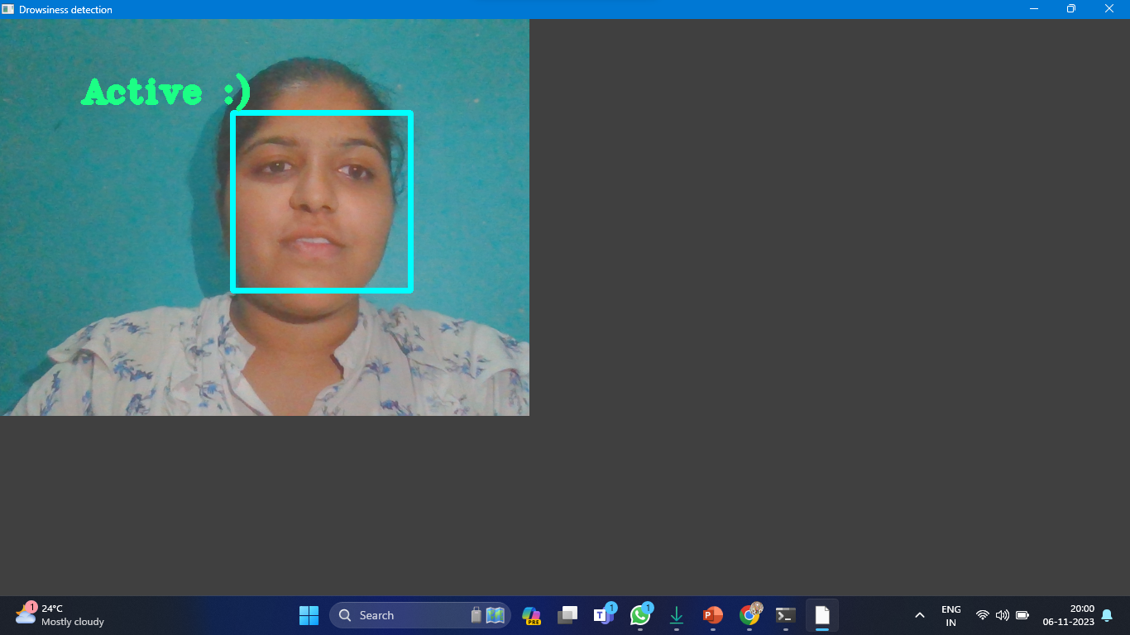
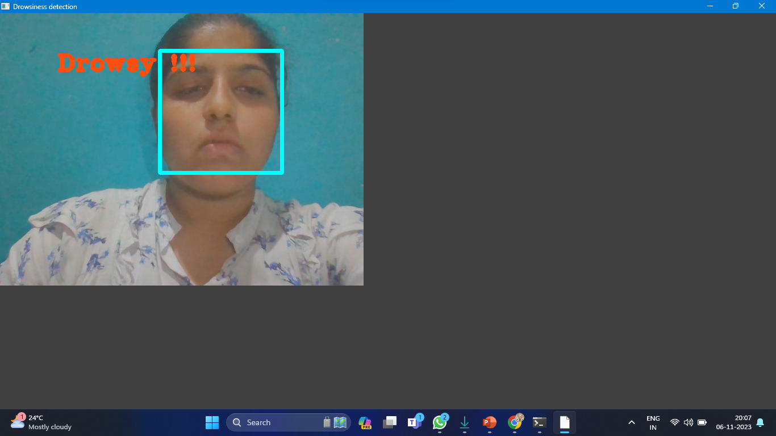
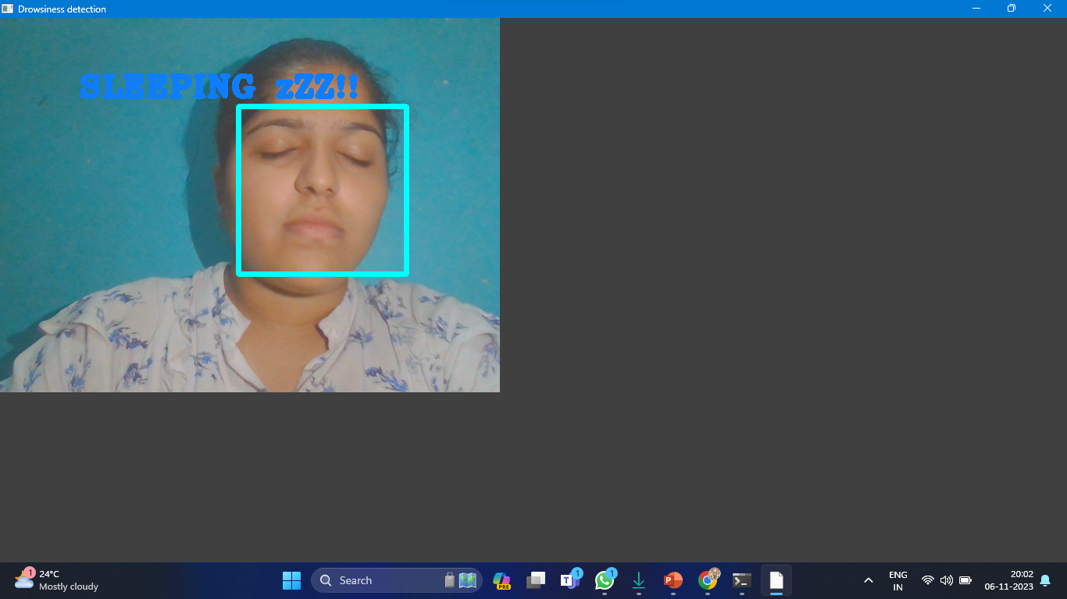
Representing drowsiness detection in which person is Active.
Representing drowsiness detection in which person is Drowsy.
Representing drowsiness detection in which person is Sleeping.

Slide 23
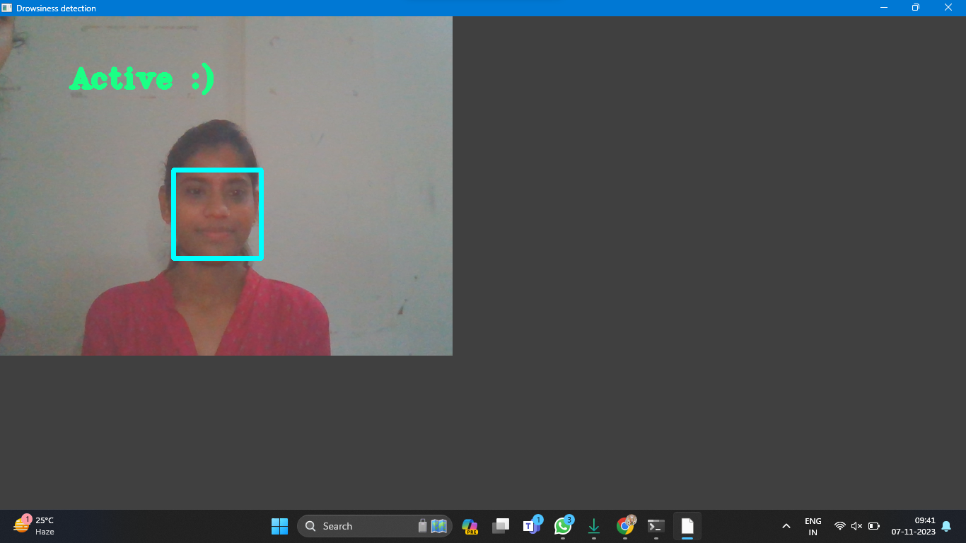
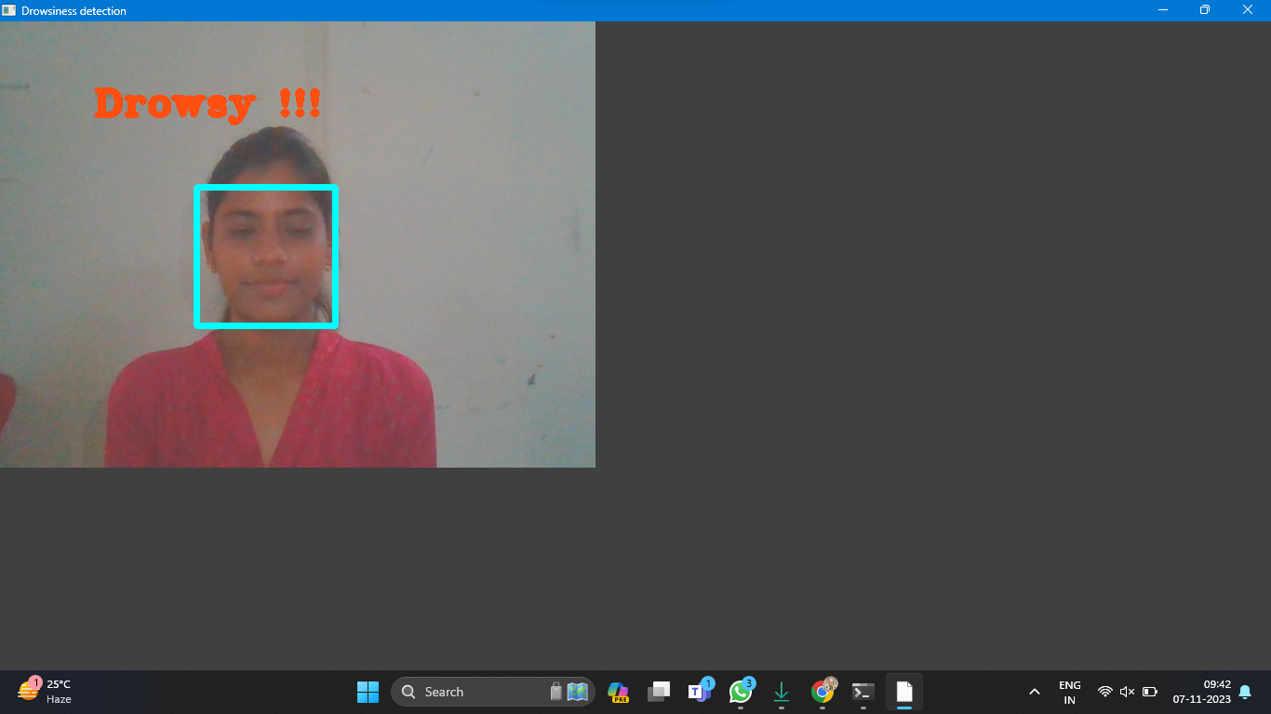
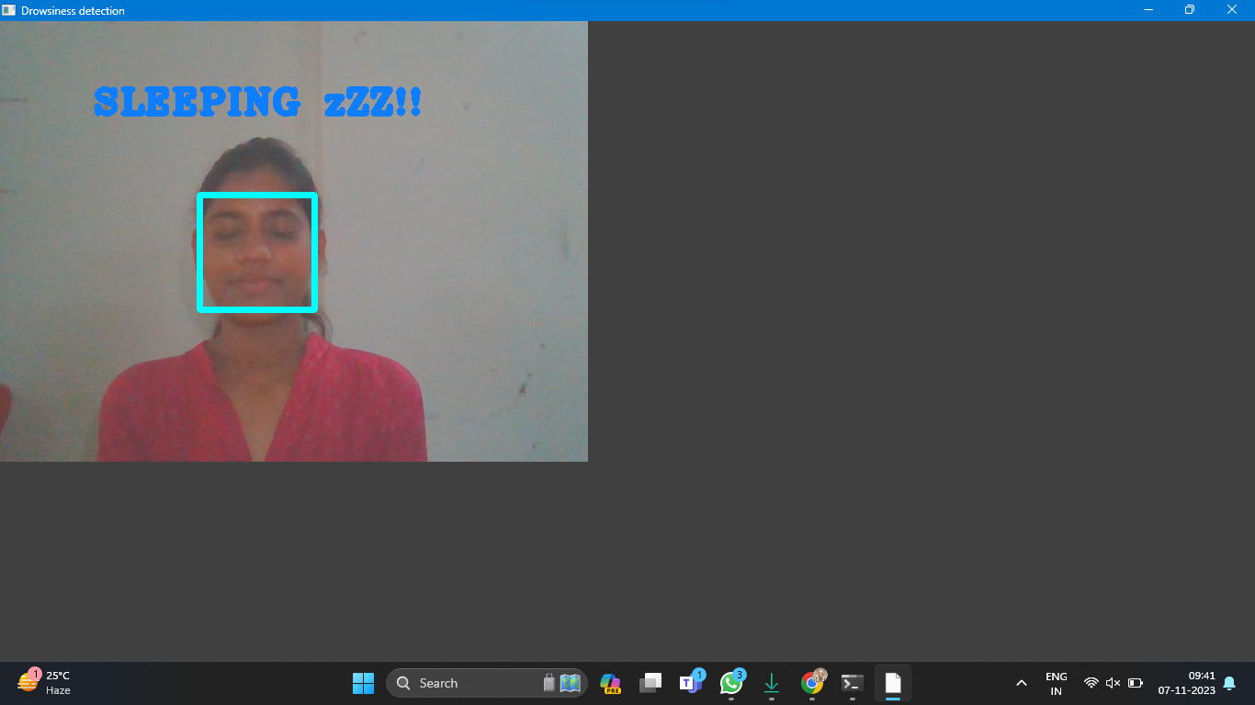
Representing drowsiness detection in which person is Active.
Representing drowsiness detection in which person is Drowsy.
Representing drowsiness detection in which person is Sleeping.

Slide 24
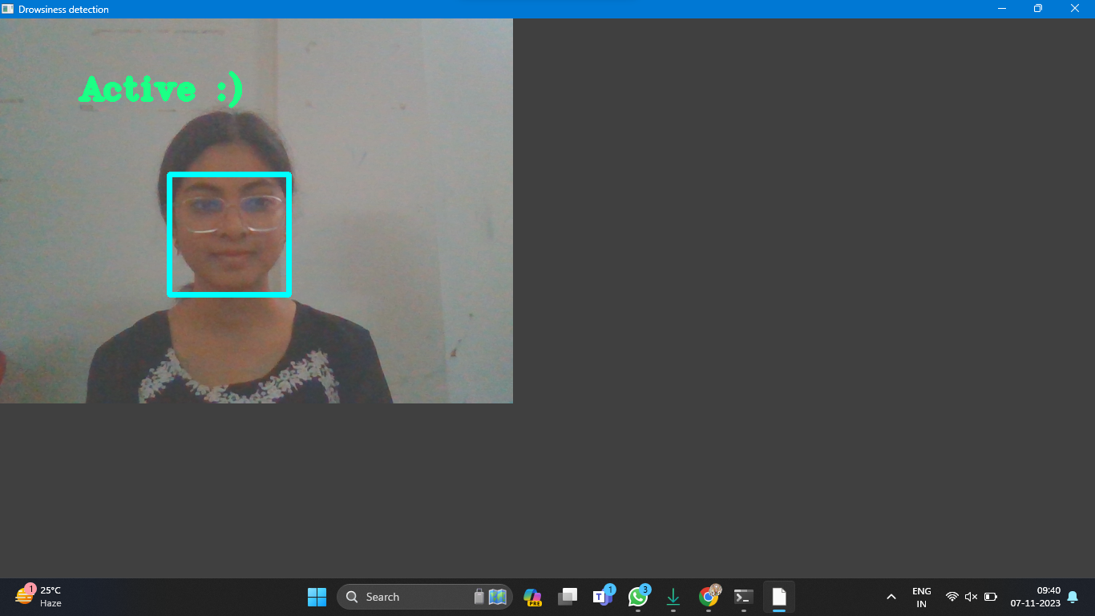
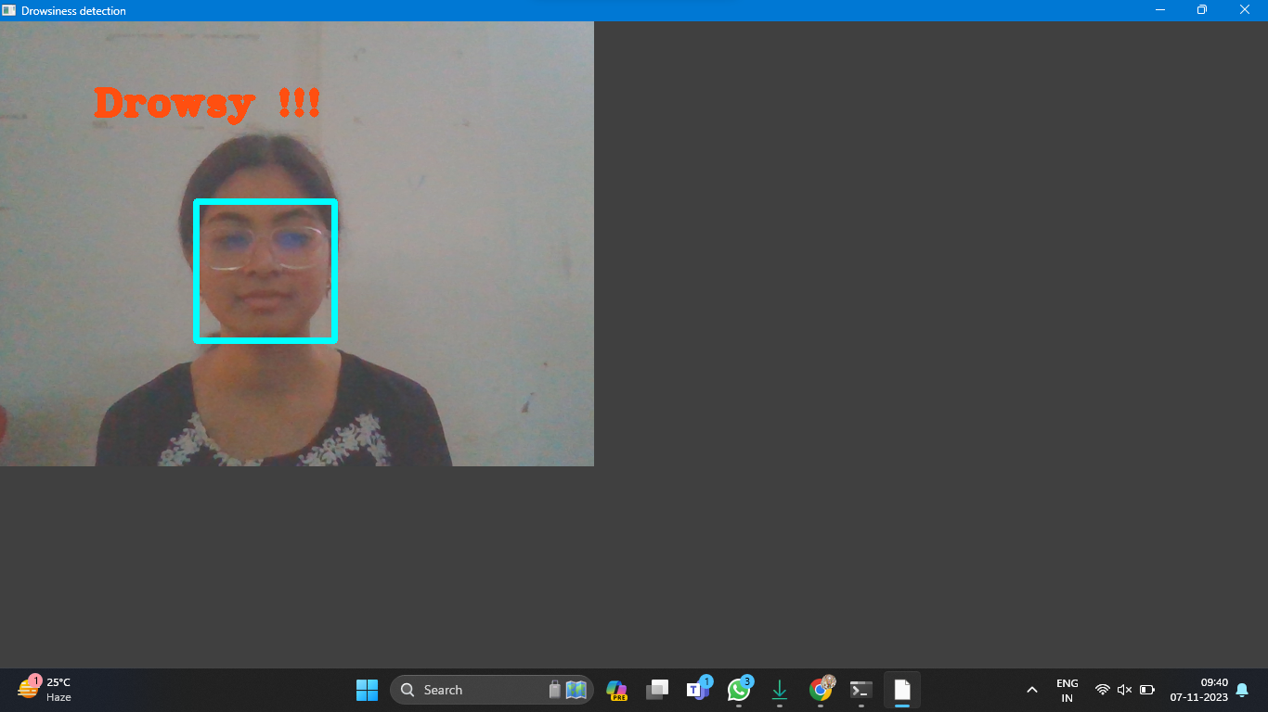
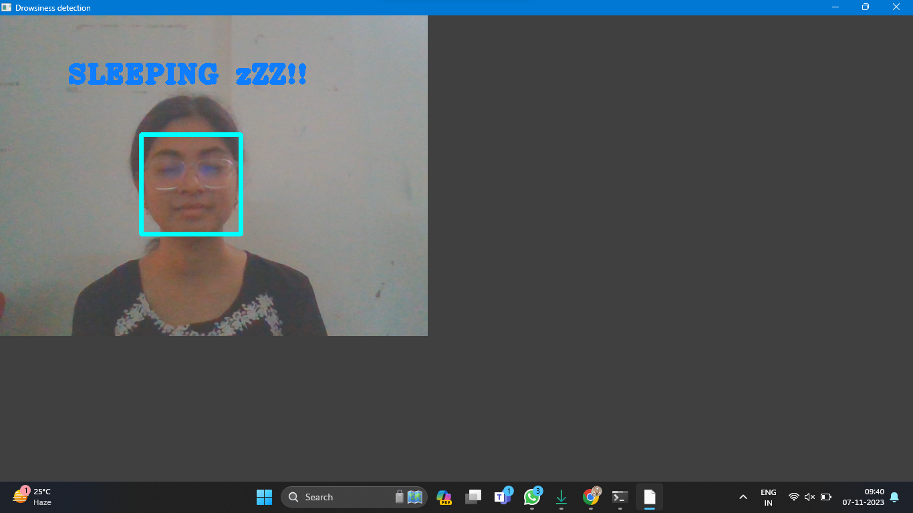
Representing drowsiness detection in which person is Active.
Representing drowsiness detection in which person is Drowsy.
Representing drowsiness detection in which person is Sleeping.

Slide 25

Multimodal Sensing
Real time feedback
Long Term monitoring
Machine learning and AI
False positive and negative
Dependency on sensors
Calibration and Personalization
Environmental Factors
Future Scope
Limitation

Slide 26
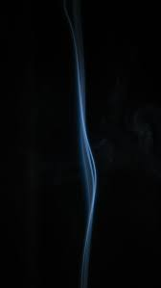
In conclusion, drowsiness detection systems represent a critical advancement in enhancing road safety by addressing the risky issue of drowsy driving. These systems have the potential to save lives and prevent accidents, but they also come with their own set of limitations and areas for improvement. Drowsiness detection systems are not only relevant to the field of automotive safety but also have practical applications and implications for students and young adults. These systems offer several key takeaways for students.
Academic Focus and future innovators
Responsibility and Accountability
Technology Integration
Safety Awareness

Slide 27

www.stackoverflow.com
www.greeksforgreeks.com
www.w3schools.com
www.python.org
www.youtube.com
www.github.com
www.kaggle.com

Slide 28


Slide 29
ANY
QUERY ?

